Slide 1
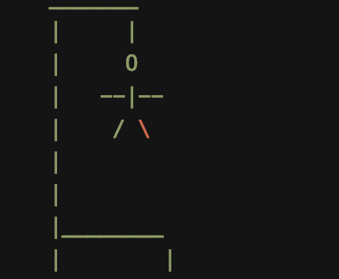
Word Catcher
AKA Hangman

Slide 2

Our Game
This game consists of two-players, creating and guessing words
One player creates the word, while the second-player guesses the letters. If correct, he/she/they will receive a point (Player 1 goes first)
In the second round, the second-player creates the word and the first-player guesses. If correct he/she/they will receive a point
This will continue on for 6 rounds total
Each player has 6 chances to guess the correct word, when they guess incorrectly a part of the Hangman’s body will be drawn and they lose a chance
If one player loses by not correctly guessing the word, the word is not added to either player’s word bank
The computer will keep track of who is winning, who is losing, and who is up next; the player with the most words in their word bank wins

Slide 3

Why Word Catcher/Hangman?
We will be using lists, word dictionaries, and loops,
These are the topics that we have learned in class and we want to demonstrate that we understand them by implementing them in a fun game. This game also fits our majors.
This game also fits our majors. Naomi is a Linguistics major, Mari is a potential Computer Science major and Raveen is an English major. Words are interesting to us and this is a game that brings back childhood memories.

Slide 4
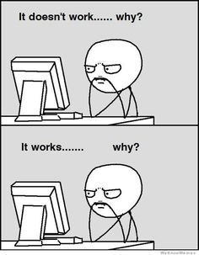
Obstacles
A player providing a word in a different language
We decided that the players would know to put in English words
What if somehow both players have the same number of words in their word bank?/ there’s a tie?
We’ve decided to just have them both win because creating a round to break the tie would just let one of the players guess, making it unfair.
How to make it more interactive
Created hangman visuals
Adding the word to the word giving player when the word guessing player didn’t correctly guess the word
We were unable to figure it out

Slide 5
Our Code: Player 1 (the word-giving player)
In order to alternate the word-giving player and the word-guessing player for each round, we created a variable called guesser in our code and set it to be true when player 1 is the guesser and it will be false when player 2 is the guesser
When the players are giving a word, we coded to prevent special characters and numbers from being accepted as an input
We converted the phrase that was given into blank underscores, so the guessing player only sees the underscores and not the actual word

Slide 6
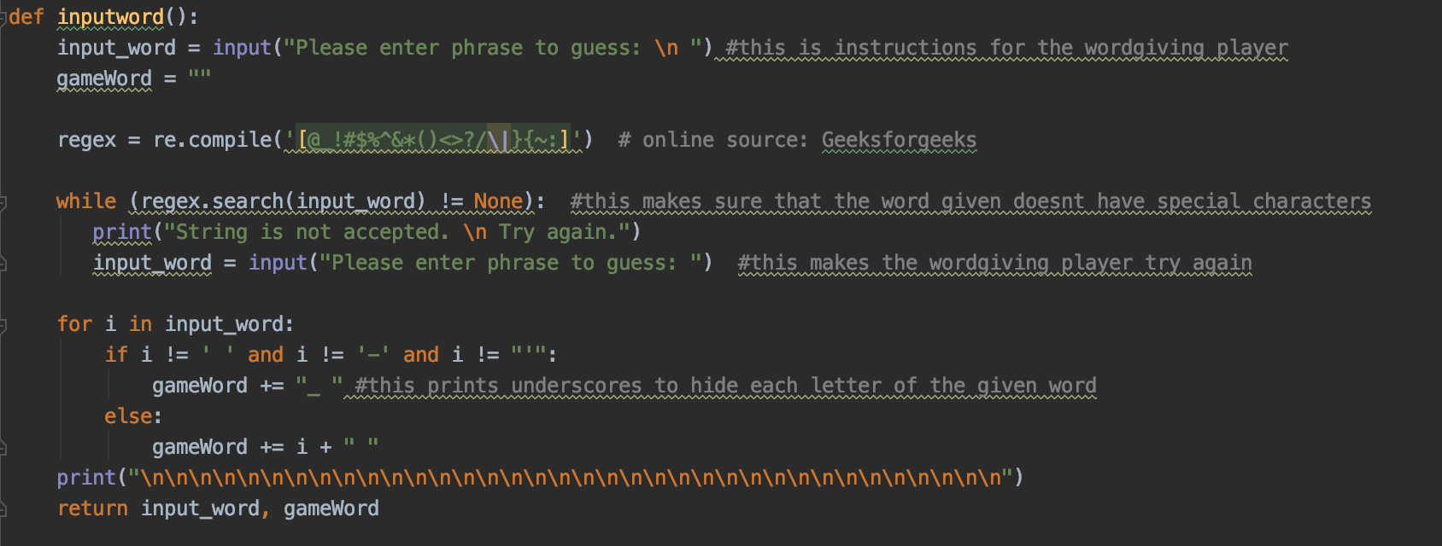
The Python Code

Slide 7
Code for Player 2 (word guessing player)
When the player is guessing, we had to figure out how to print the remaining chances in time with the numbers of incorrect guesses.
We also had to figure out how to prevent the guessing player from guessing a special characters and numbers
We figured out how to add the correctly guessed word into the word bank of player 2
We figured out how to display the letters that were guessed, but were not in the word given by player 1

Slide 8
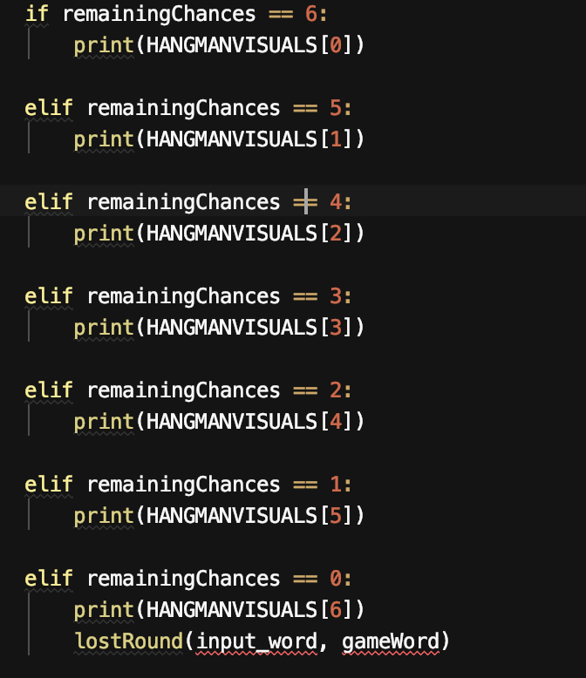
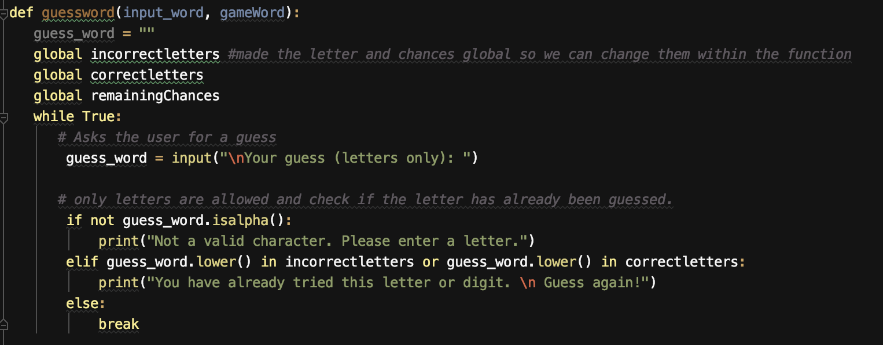
The Python Code

Slide 9
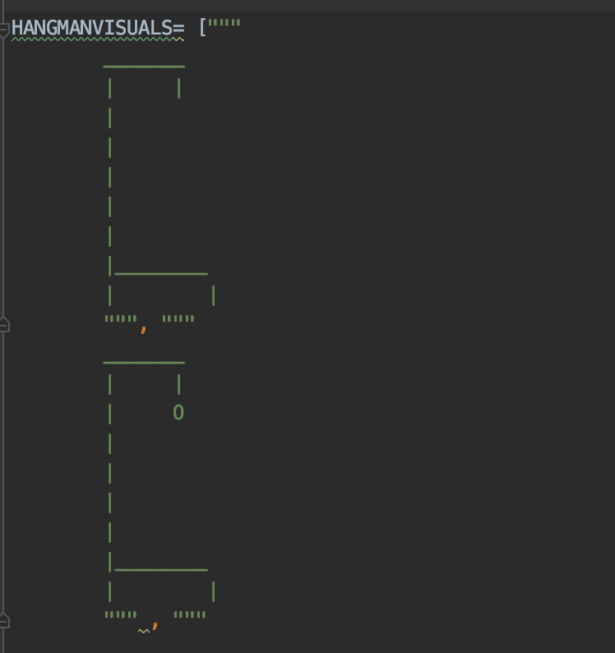
Hangman Visuals
We coded the specific design of the Hangman visual, building on the design and putting it under each code to make sure that the visual pops up with incorrectly guessed letter. Giving the guessing player six chances
We created a list of the visuals to be used and then as each remaining chance decreases we accessed each element of the list using its index number
At first, we tried using turtle, but it didn’t work because it only makes a visual for a specific action, it can’t add onto it

Slide 10
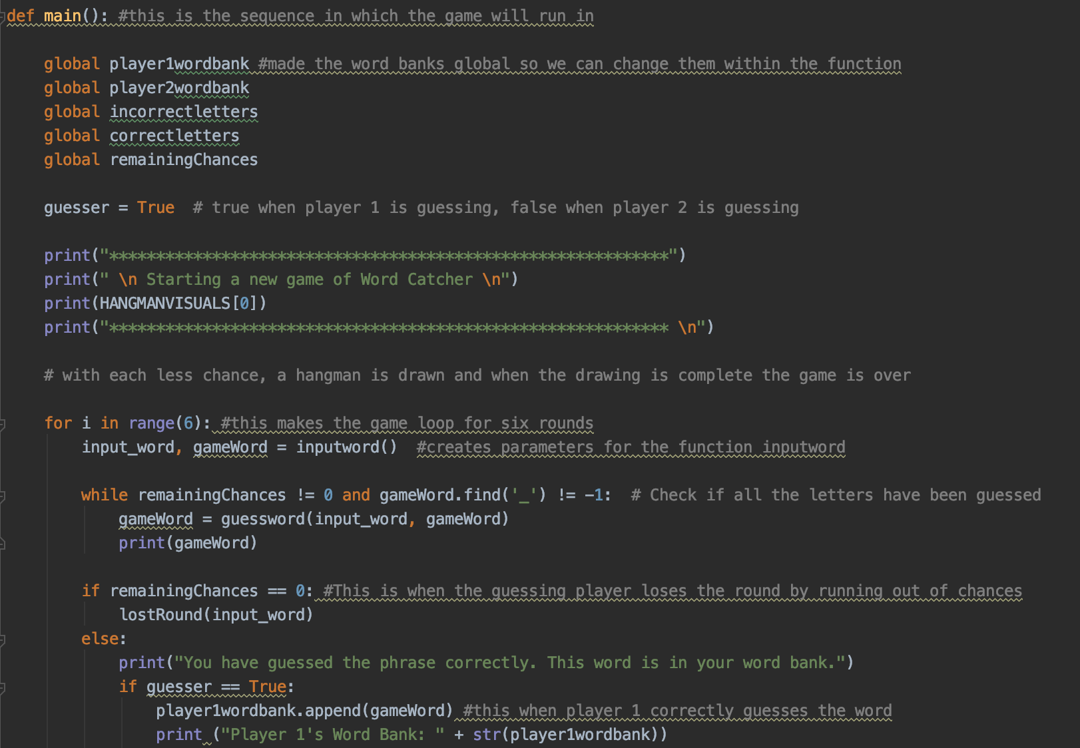
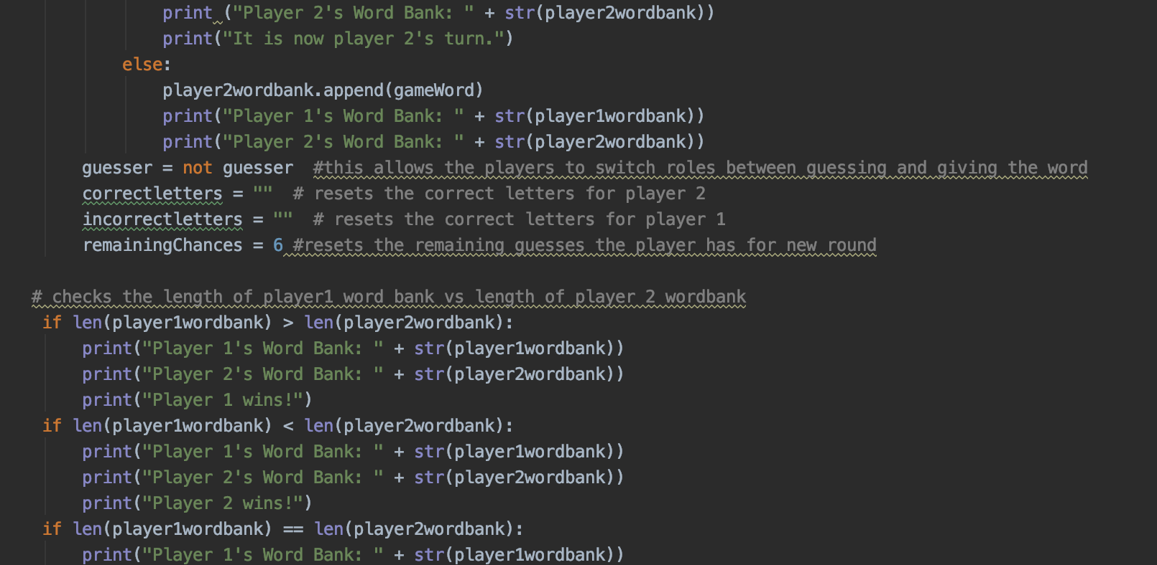
Main Code (executes the game)

Slide 11
Work Schedule (16 hours)
Mari | Raveen | Naomi
Code that allows input for players to give the phrase and input for players to guess the phrase Code that allows input for players to give the phrase and input for players to guess the phrase Code that matches the letter guessed to the letter in the word and replaces the underlined space with the letter Code that matches the letter guessed to the letter in the word and replaces the underlined space with the letter Code that matches the letter guessed to the letter in the word and replaces the underlined space with the letter Mari:Code that alternates between which player goes first in each round Mari: Code that alternates between which player goes first in each round | Code that gives output when the letter inputted by the player is in the phrase being guessed/ when it’s not Code that gives output when the letter inputted by the player is in the phrase being guessed/ when it’s not Code that puts the same letter in multiple places if it appears more than once in the phrase Code that puts the same letter in multiple places if it appears more than once in the phrase Code that puts the same letter in multiple places if it appears more than once in the phrase Code that keeps track of remaining chances and ends the game Code that ends the game | Code that turns the letters in the words into underlined spaces and gives this new format to player 2 Code that turns the letters in the words into underlined spaces and gives this new format to player 2 Code to keep track of words that player 1 has guessed and player 2 has guessed Code to keep track of words that player 1 has guessed and player 2 has guessed Code to keep track of words that player 1 has guessed and player 2 has guessed Code to raise exceptions if numbers or symbols are entered instead of string Naomi: Code to raise exceptions if numbers or symbols are entered instead of string Working on any unforeseen risks that occur and test cases & presentation (all of us)

Slide 12
Demo
Github Link: https://github.com/haverfordcs/105project-delacruz-kalombo-green

